Slide 1
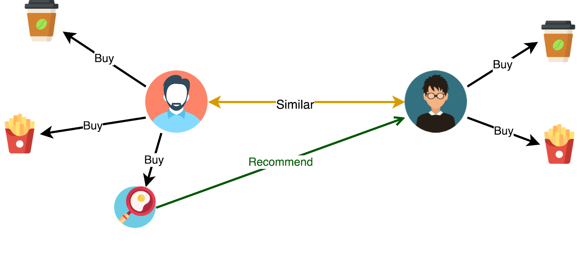
Restaurants recommendator
Mariloy Hernández, Jesus Antonio, Jesus Molina & Karla Plazas

Slide 2
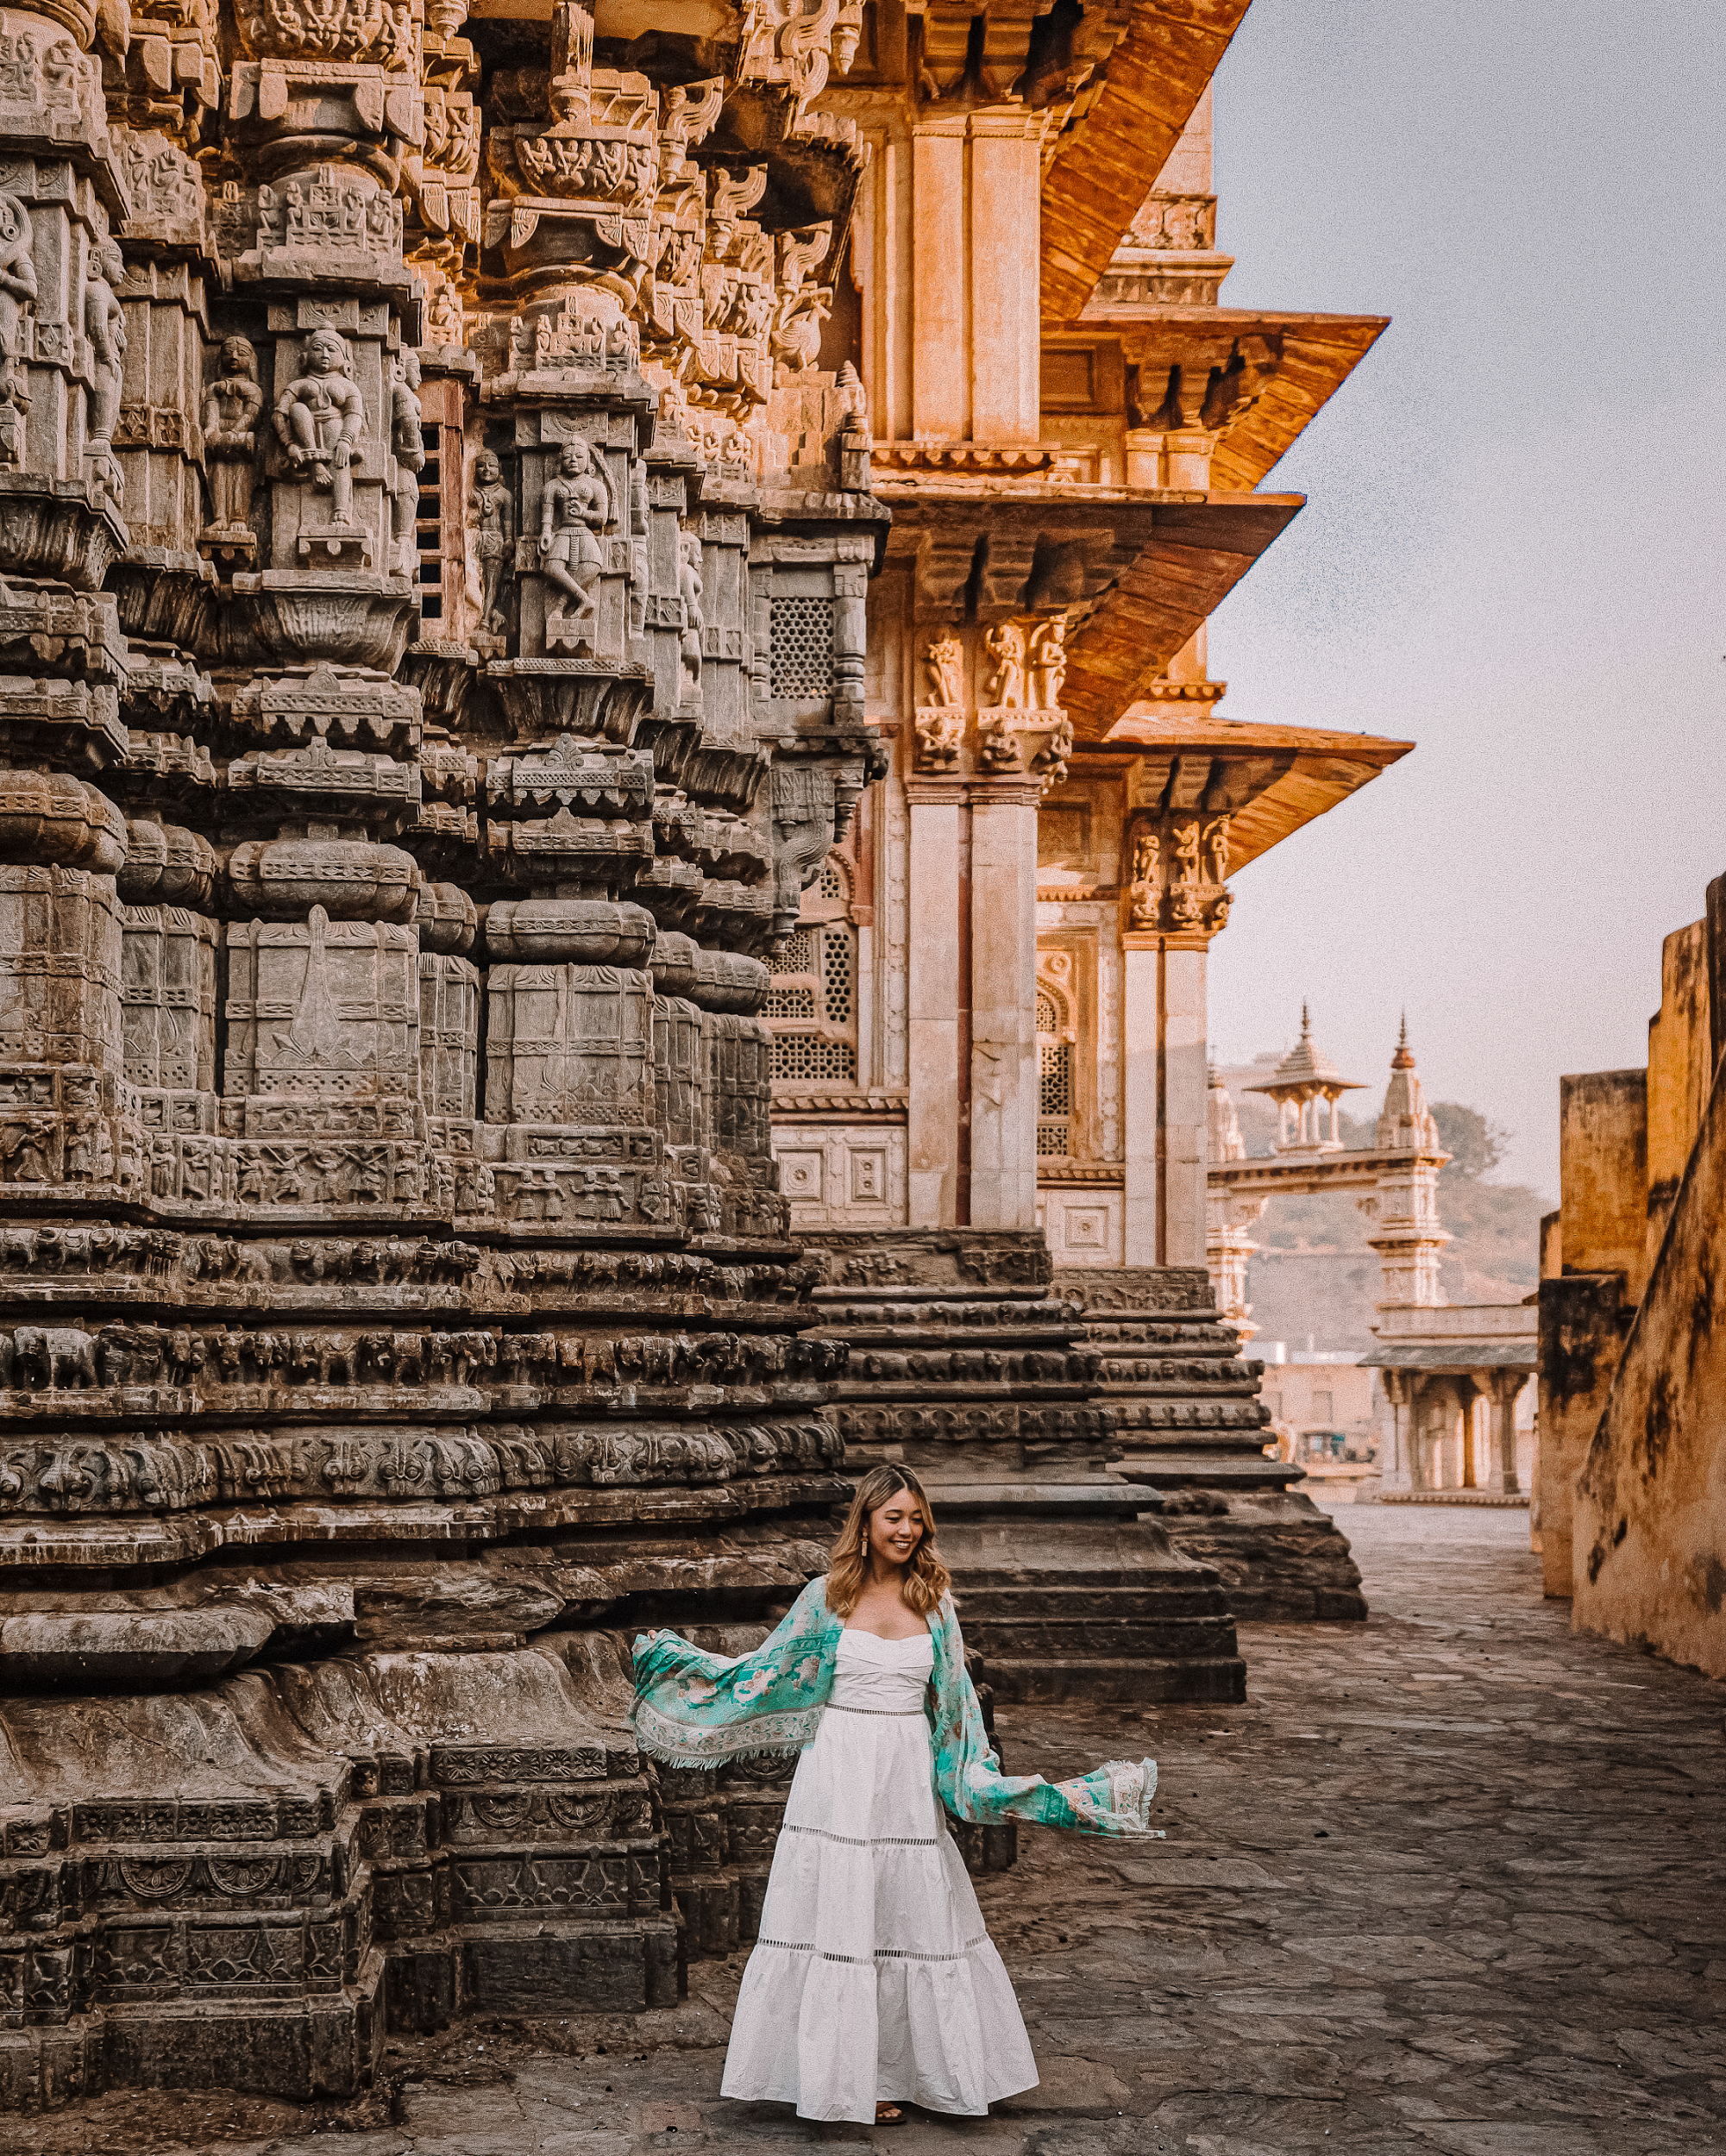
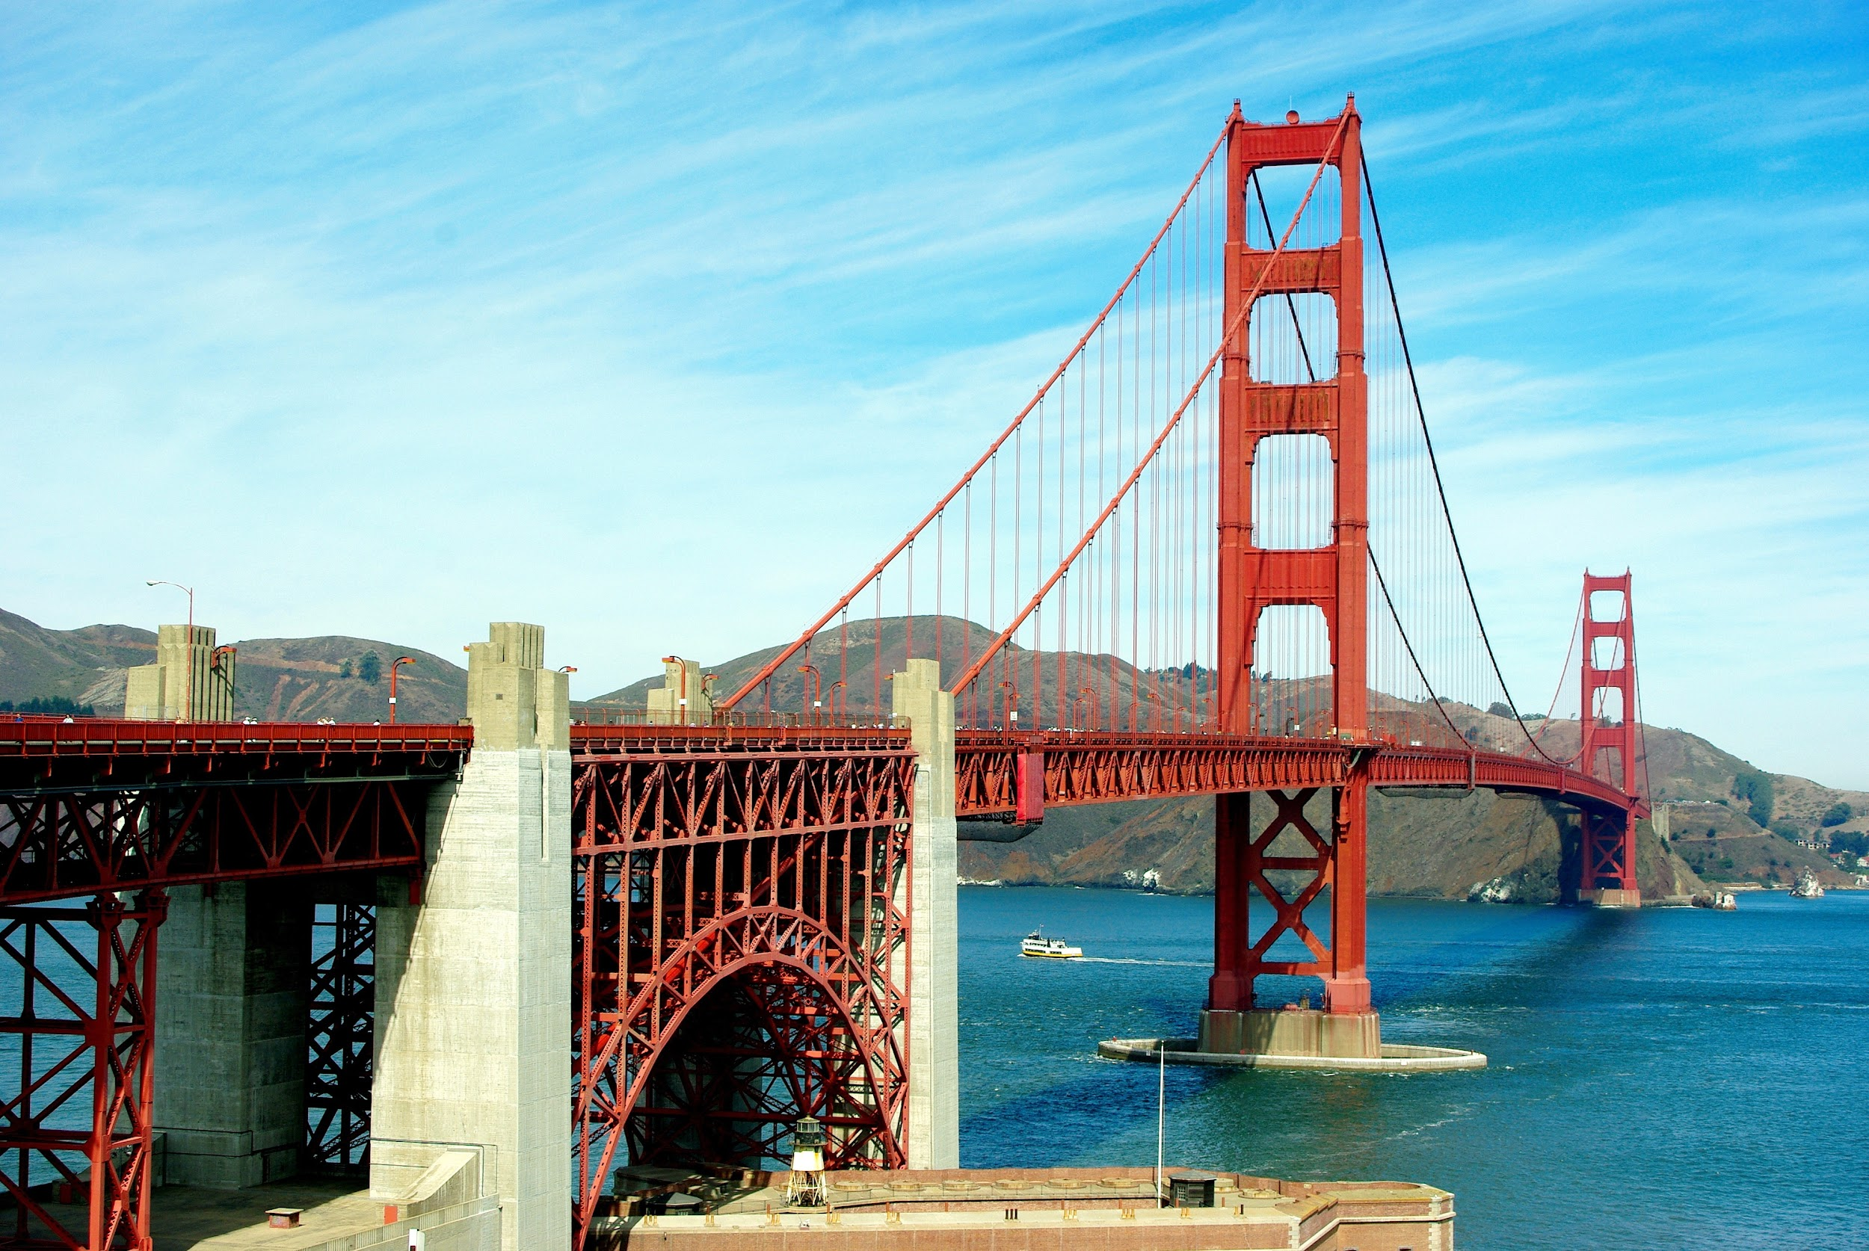
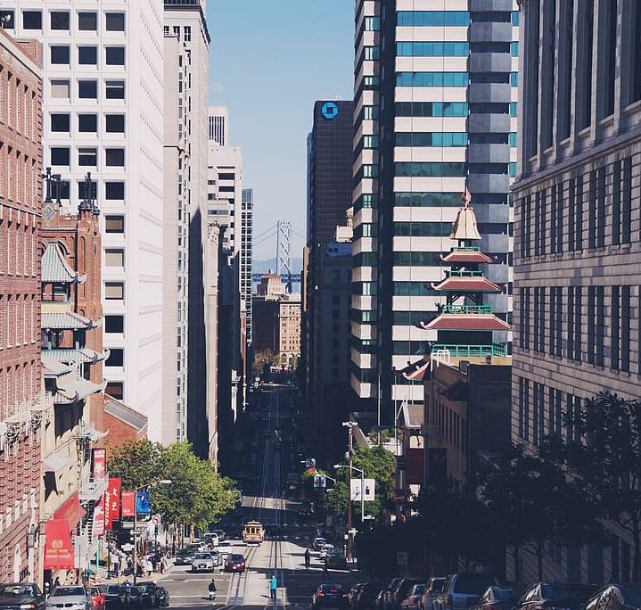
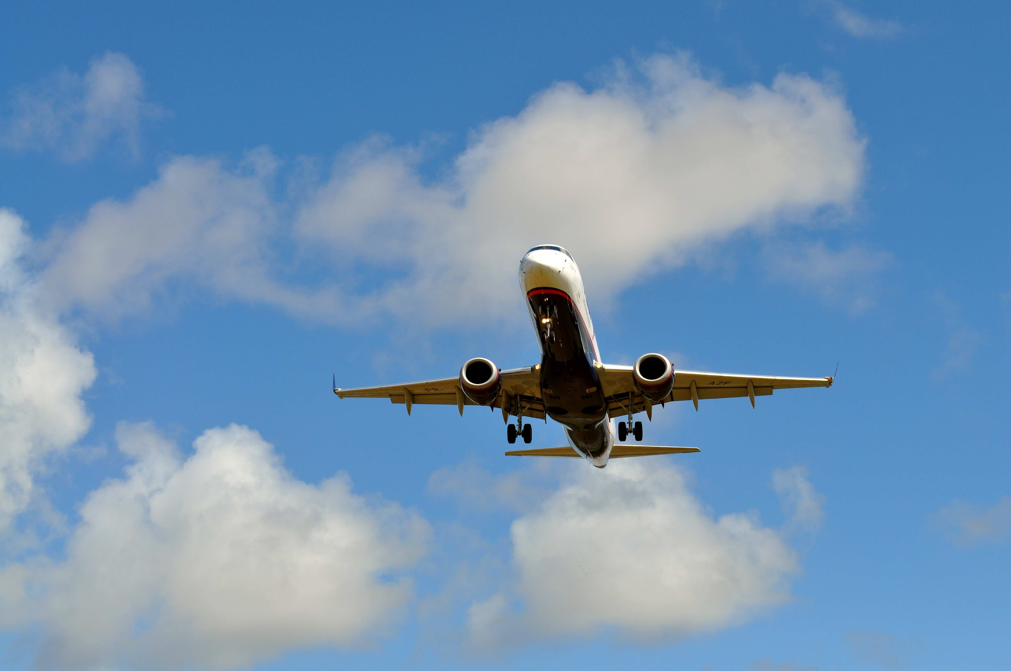

Slide 3

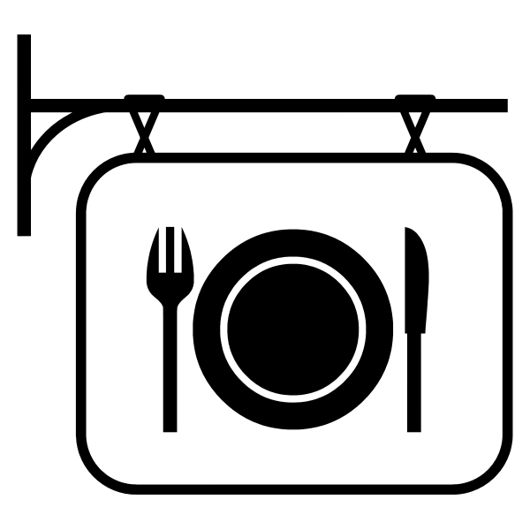
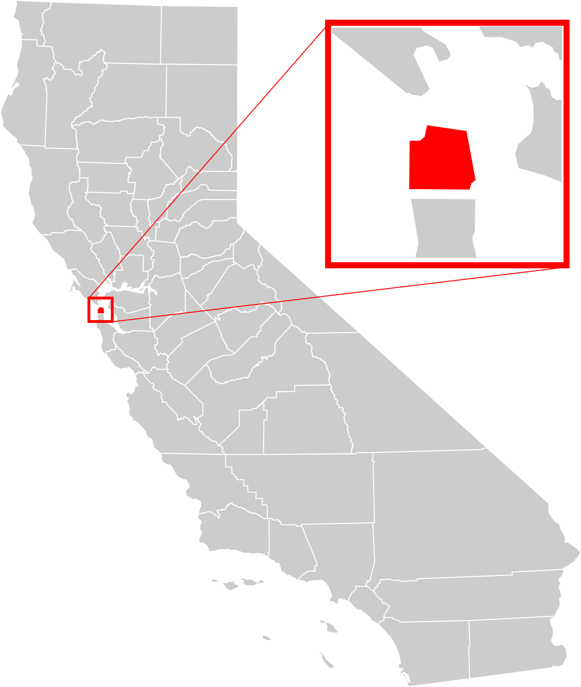

San Francisco
More than 4,300 restaurants
Time Restraint
Total area: 600.7km²
Too many options
Land: 121km², Water: 479.7km²
Location & Preferences
Tourism:
2019:around 26M
2022: 21M *Forecast*
What is the best option & the best route?

Slide 4

what questions do we want to solve

Slide 5
main questions

Slide 6

How Does the Restaurants Recommendator work?

Slide 7
Restaurants recommendator
1
2
3
Enter our web page, select the starting point and write 3 words of what you want to have in the restaurant
(example: romantic, view, outside).
Our model will select the best restaurants for you according to the starting point (close to you) and according with the 3 words you wrote.
Those restaurants will be mapped in the web page with the best route so you can have your whole day planned with your food for the day while you enjoy your vacations!

Slide 8

Data Source

Slide 9

data source

